Slide 1
Session 1: What is machine learning?
What will you accomplish today ?
Real-life machine learning example from the banking industry
Excuse to introduce some jargon
Working definition: Oh… So, this is machine learning?
Working definition: Is that all there is to it?
Supervised Learning
Unsupervised Learning
Class Project: Face Emotion Classification
Market Segmentation (Data)
Market Segmentation (K=15, Kmeans Clustering)
Machine Learning versus Other Things
Meet your first (ridiculously simple) classifier
An abstract look at the first classifier. How does it work?
Practical Motivation: An example from biometrics
Histograms (movie)
Relevance of histograms for classification
“Regular” Histogram of teachers’ height
Normalized Histogram of teachers’ height
“Regular” Histogram of engineers’ height
Normalized Histogram of engineers’ height
More and more bins. Good or bad?
More and more bins. More and more samples.
Different choices for showing the length of bars in histograms
Density histograms are special
Density Histograms to PDFs
Understanding probability density functions (PDFs)
The wrong and right way of thinking about PDFs
Mean, median, standard deviation … Boring statistics
Histograms, PDFs and probabilities
Bayes Classifier
Bayes Classifier (with textbook notation)
Bayes Classifier (also, Theorem)
Multi-class, multidimensional generalizations
Step-by-Step: Pseudocode for computing the histogram
Step-by-Step: Homework Assignment 1 (unofficial, always refer to the course website)
Step-by-Step: Homework Assignment 1
Session 1 Summary

Slide 2
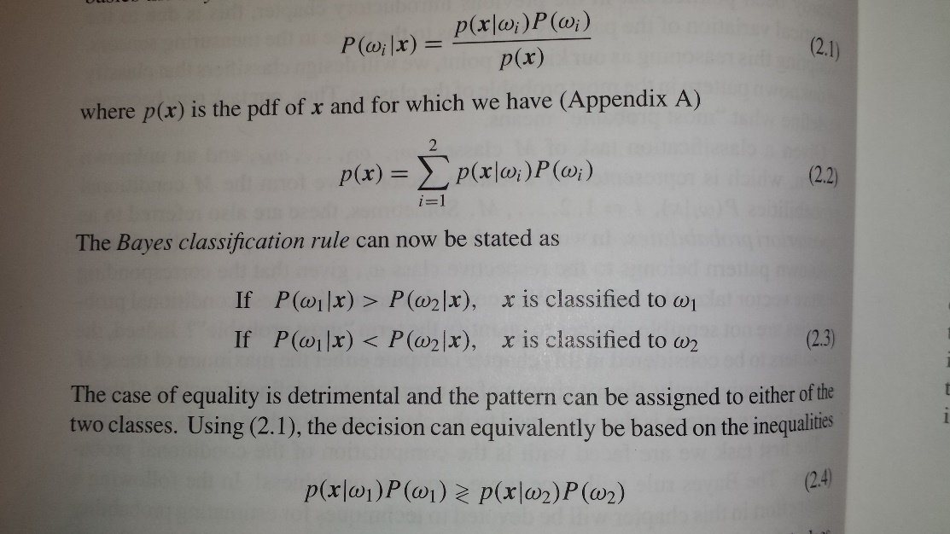
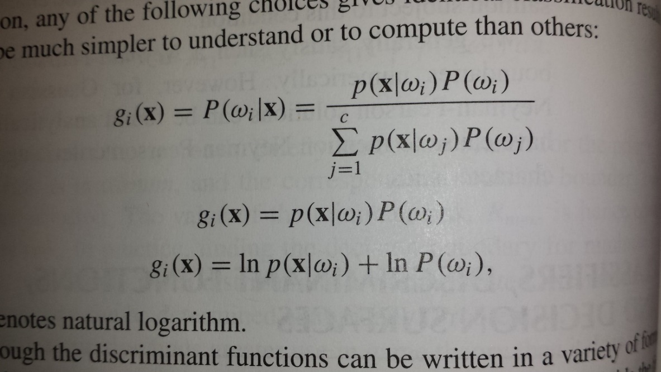
What will you accomplish today ?
Right after your very first class, go home with the knowledge to program two classifiers!
Know how to build multidimensional, multiclass classifiers! Yes. That is a stretch but is essentially correct.
Look at this slide again after Session 1

Slide 3
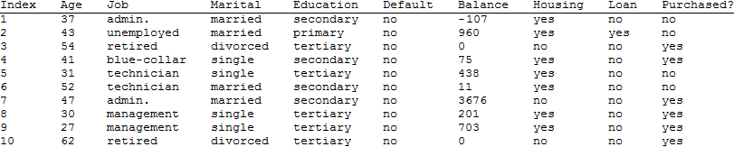
Real-life machine learning example from the banking industry
The machine learning problem
Alice works in a bank that actively sells loans.
She needs to meet her daily sales quota.
She has basic information on Bob, including his phone number.
She is worried that she will have to spend 30 minutes talking to Bob with no guarantee of closing any deal.
Should she call Bob, or move on to the next potential customer?
A possible solution
Look at records of similar individuals and check if a successful sale was made.
A look at some of the data (partial)
S. Moro, R. Laureano and P. Cortez. Using Data Mining for Bank Direct Marketing: An Application of the CRISP-DM Methodology. In P. Novais et al. (Eds.), Proceedings of the European Simulation and Modelling Conference - ESM'2011, pp. 117-121, Guimarães, Portugal, October, 2011. EUROSIS.
A new candidate's financial variables must be compared against entries in a huge database and a prediction must be computed.

Slide 4
Excuse to introduce some jargon
Training Set
Ordinal
Nominal
Nominal
Nominal
Nominal
Ordinal
Nominal
Nominal
Class label
Features
Feature Vector
also called pattern

Slide 5

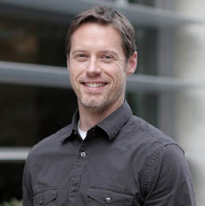
Working definition: Oh… So, this is machine learning?
Classifier Usage
Classifier
Feature Vector
Output Class Label
Classifier Design
Learning Algorithm
Training set
Classifier
(Feature Vectors+
Known Class Labels)
Eric Graham, you have been honored with the Eagle Eye Award for spotting an error or omission on this slide.
Congratulations and thank you for your help in improving this presentation.
CLICK TO DISMISS
This is also known as supervised learning (learning from examples)
*These definitions cover most, but not all of machine learning

Slide 6
Working definition: Is that all there is to it?
Classifier Usage
Classifier
Groupings or
Clusters of
patterns
Input patterns
This is also known as unsupervised learning (learning without examples)

Slide 7
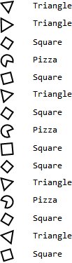



Supervised Learning
Training set
Classifier
Query
Result
Too easy! Query has exact match in the training set
Classifier
Query
Result
To be practically useful, a classifier must have the ability to generalize on learning from training examples
Classifier
Query
Result
Supervised learning: You teach the system by showing it examples

Slide 8

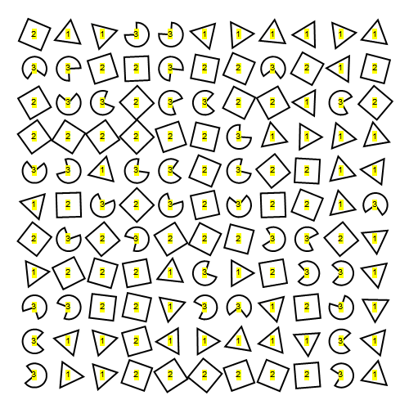
Unsupervised Learning
No class labels provided
Unsupervised learning algorithm produces groupings
A human may examine the groupings to understand the significance. E.g.
1 → Triangle
2 → Square
3 → Pizza
Unsupervised learning: Let the system discover what can be learned

Slide 9

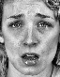
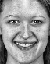


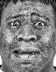


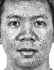

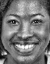
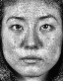



Class Project: Face Emotion Classification
Training set
Queries
Neutral
Sad
Happy
Neutral
Sad
Happy

Slide 10
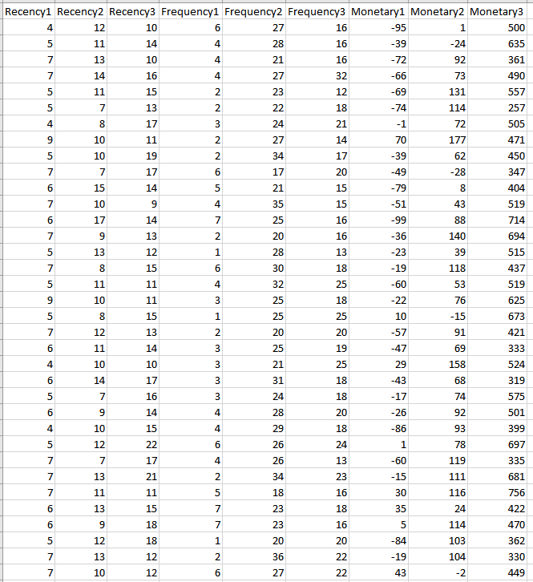
Market Segmentation (Data)

Slide 11
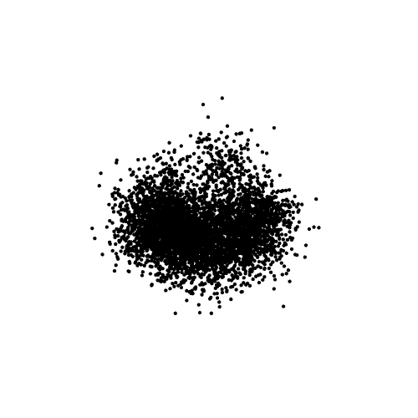
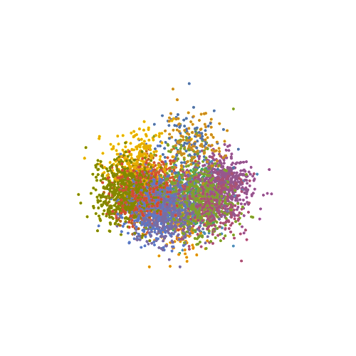
Market Segmentation (K=15, Kmeans Clustering)

Slide 12
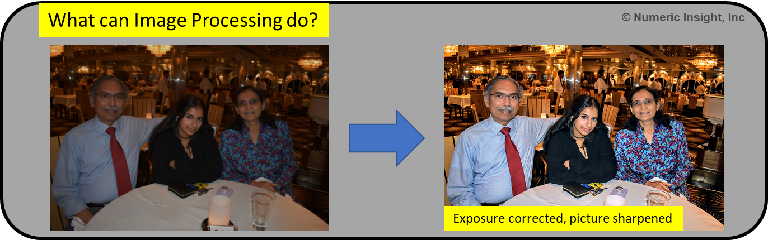
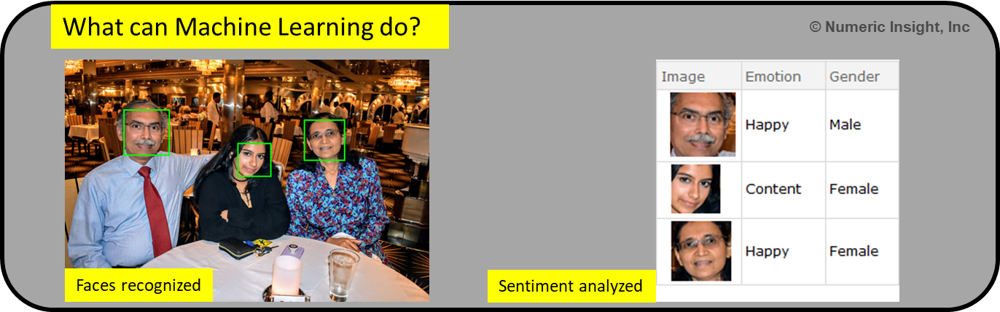
Machine Learning versus Other Things

Slide 13
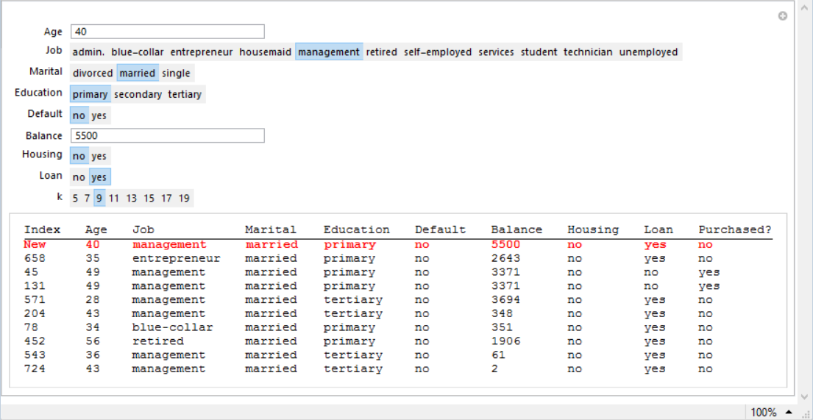
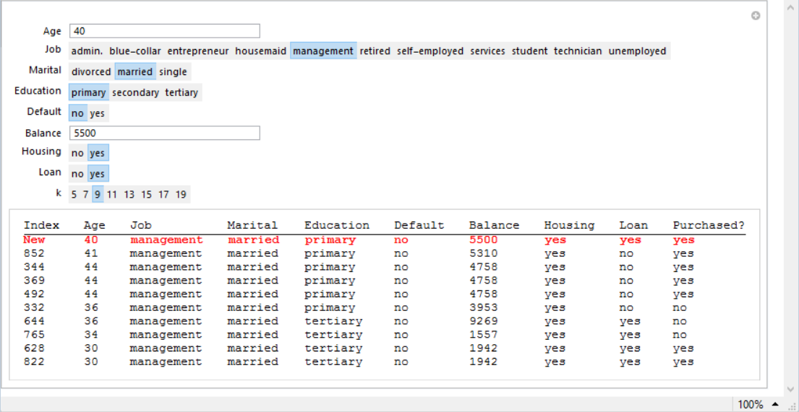
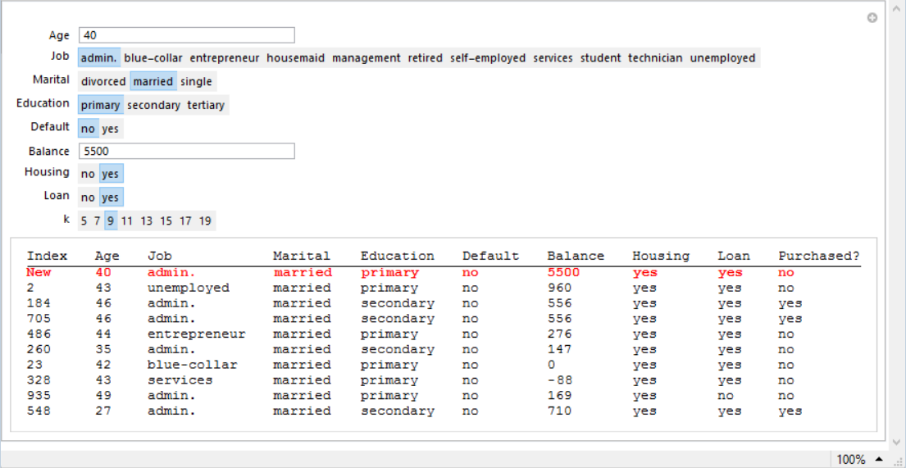
Meet your first (ridiculously simple) classifier
Query
Prediction
The algorithm retrieves feature vectors similar to the query vector

Slide 14
An abstract look at the first classifier. How does it work?
User inputs a correctly formed feature vector. [User “queries.”]
The algorithm searches the training set and retrieves the subset of 9 feature vectors closest to the input feature vector.
The algorithm assigns the class label of the input feature vector to the commonest of the class labels associated with the feature vectors of the subset.
Our next example might seem very different but is really based on the same principles.

Slide 15
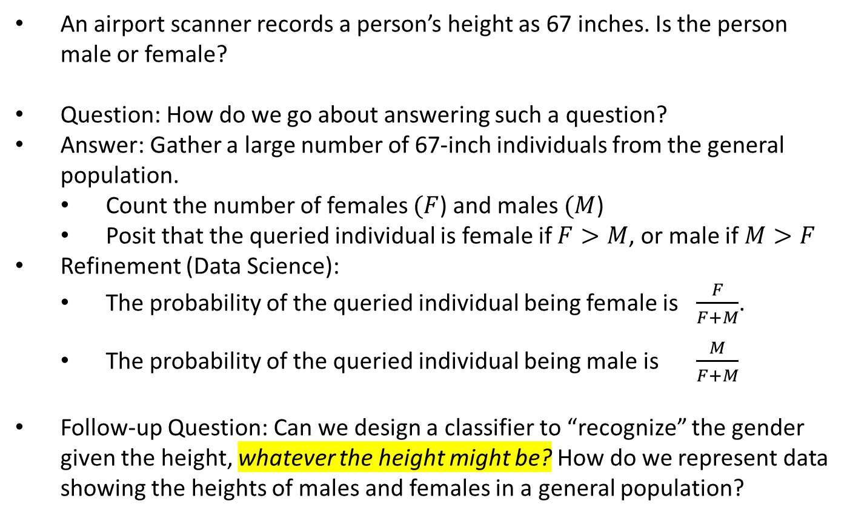
Practical Motivation: An example from biometrics
An airport scanner records a person’s height as 67 inches. Is the person male or female?
Question: How do we go about answering such a question?
Answer: Gather a large number of 67-inch individuals from the general population.
Count the number of females $(F$) and males $(M$)
Posit that the queried individual is female if $F>M$, or male if $M>F$
Refinement (Data Science):
The probability of the queried individual being female is $\frac{F}{F+M}$.
The probability of the queried individual being male is $\frac{M}{F+M}$
Follow-up Question: Can we design a classifier to “recognize” the gender given the height, whatever the height might be? How do we represent data showing the heights of males and females in a general population?
Note: This is not merely a textbook exercise. Biometric systems used in security and authentication actually use the concepts described here.

Slide 16
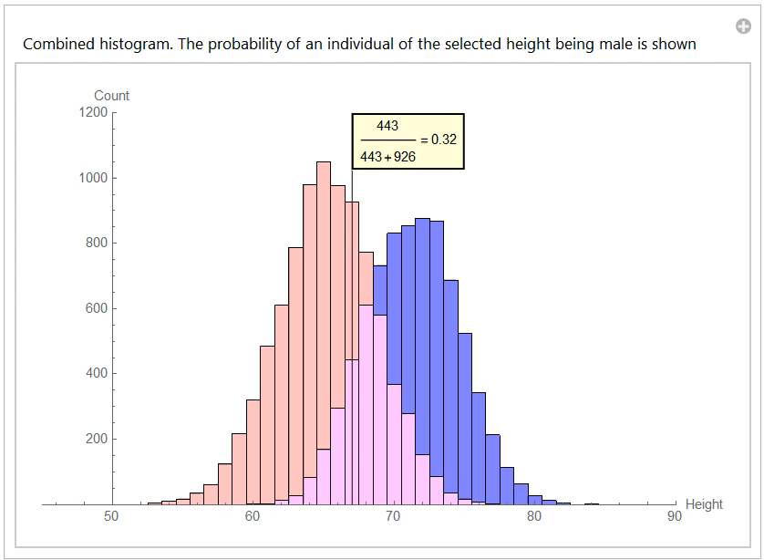
Histograms (movie)

Slide 17
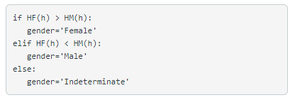
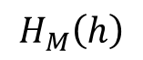
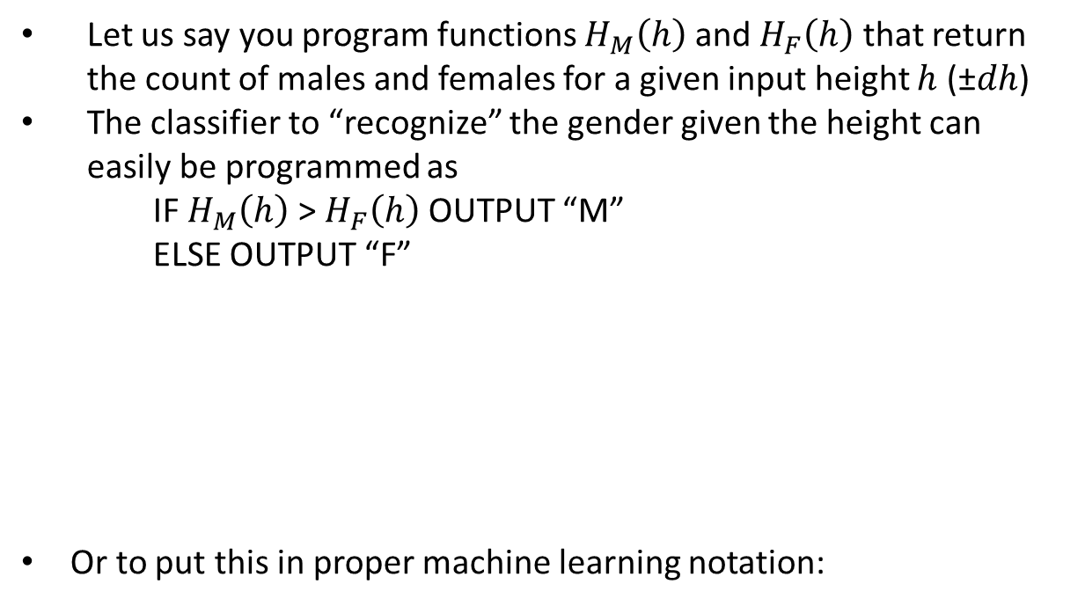
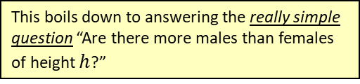
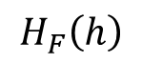
Relevance of histograms for classification
Let us say you program functions $H_{M}\left(h\right)$ and $H_{F}\left(h\right)$ that return the count of males and females for a given input height $h$ (±$dh$)
The classifier to “recognize” the gender given the height can easily be programmed as
IF $H_{M}\left(h\right)$ > $H_{F}\left(h\right)$ OUTPUT “M”
ELSE OUTPUT “F”
Or to put this in proper machine learning notation:
This boils down to answering the really simple question “Are there more males than females of height $h$?”
Effectively we have implemented
Search and retrieval of training feature vectors similar to the input feature vector
Assignment of class to the commonest of the class labels.
M
$$H_{M}\left(h\right)$$
>
$$H_{F}\left(h\right)$$
<
F

Slide 18
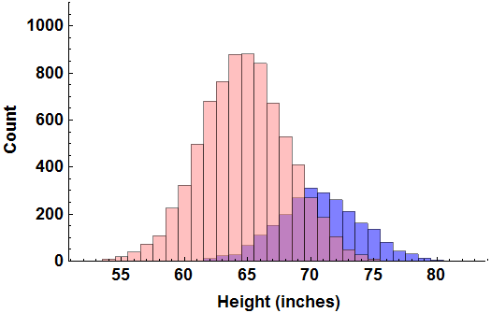

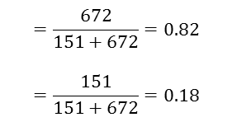
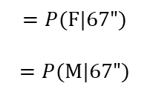
“Regular” Histogram of teachers’ height
672 Female teachers
with height 67”
151 Male teachers
with height 67”
If we are asked to guess the gender of a new 67” teacher, we would refer to the above regular histogram and decide the gender based on the following two computed probabilities:
Probability of being female, given h=67”
Probability of being male, given h=67”
Akhila Basapuram Vidapanapati, you have been honored with the Eagle Eye Award for spotting an error or omission on this slide.
Congratulations and thank you for your help in improving this presentation.
CLICK TO DISMISS
$$=\frac{672}{151+672}=0.82$$
$$=\frac{151}{151+672}=0.18$$
$$=P(F|67")$$
$$=P(M|67")$$

Slide 19
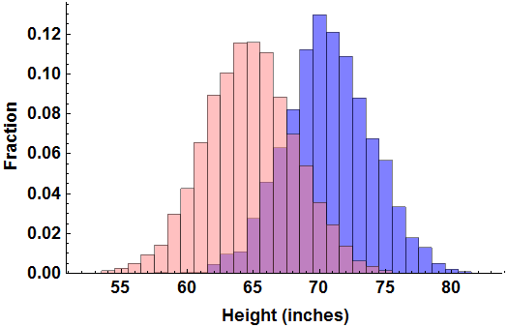
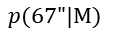
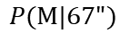
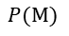
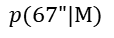
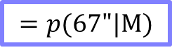
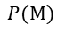
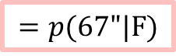
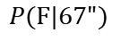
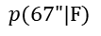
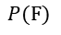
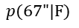
Normalized Histogram of teachers’ height
0.08842 Fraction of female teachers with height 67”
7600 Female
teachers
$$=p(67"|F)$$
0.06291 Fraction of male teachers with height 67”
$$=p(67"|M)$$
2400 Male
teachers
If we are asked to guess the gender of a new 67” teacher, we would refer to the above normalized histogram AND the additional information on prevalence and decide the gender based on the following two computed probabilities:
Probability of being female, given h=67”
Probability of being male, given h=67”
7600
×
0.08842
=
$$P(F)$$
$$p(67"|F)$$
=
$$P(F|67")$$
0.82
7600
×
0.08842
+
2400
×
0.06291
$$P(F)$$
$$p(67"|F)$$
$$P(M)$$
$$p(67"|M)$$
2400
×
0.06291
=
$$P(M)$$
$$p(67"|M)$$
=
$$P(M|67")$$
0.18
7600
×
0.08842
+
2400
×
0.06291
$$P(F)$$
$$p(67"|F)$$
$$P(M)$$
$$p(67"|M)$$

Slide 20
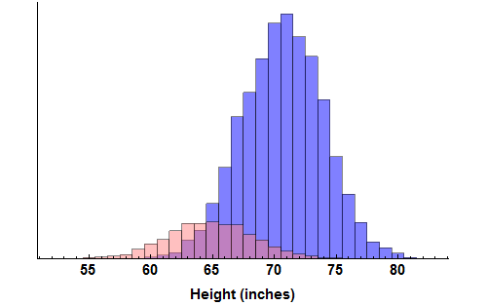
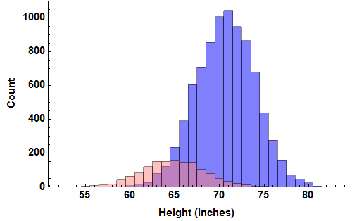
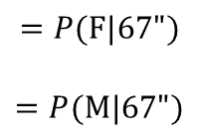
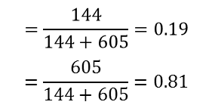
“Regular” Histogram of engineers’ height
144 Female engineers
with height 67”
605 Male engineers
with height 67”
If we are asked to guess the gender of a new 67” engineer, we would refer to the above regular histogram and compare the two probabilities:
Probability of being female, given h=67”
Probability of being male, given h=67”
$$=\frac{144}{144+605}=0.19$$
$$=\frac{605}{144+605}=0.81$$
$$=P(F|67")$$
$$=P(M|67")$$

Slide 21
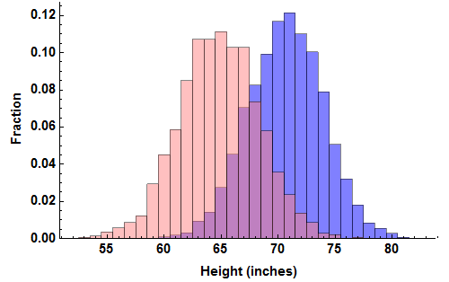
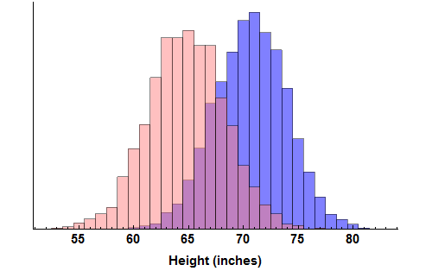

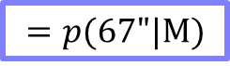
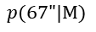


Normalized Histogram of engineers’ height
0.1028 Fraction of female engineers with height 67”
1400 Female
engineers
$$=p(67"|F)$$
0.0704 Fraction of male engineers with height 67”
$$=p(67"|M)$$
8600 Male
engineers
If we are asked to guess the gender of a new 67” engineer, we would refer to the above normalized histogram AND the additional information on prevalence and compare the two probabilities:
Probability of being female, given h=67”
Probability of being male, given h=67”
1400
×
0.1028
=
$$P(F)$$
$$p(67"|F)$$
=
$$P(F|67")$$
0.19
1400
×
0.1028
+
8600
×
0.0704
$$P(F)$$
$$p(67"|F)$$
$$P(M)$$
$$p(67"|M)$$
8600
×
0.0704
=
$$P(M)$$
$$p(67"|M)$$
=
$$P(M|67")$$
0.81
1400
×
0.1028
+
8600
×
0.0704
$$P(F)$$
$$p(67"|F)$$
$$P(M)$$
$$p(67"|M)$$

Slide 22






More and more bins. Good or bad?

Slide 23






More and more bins. More and more samples.

Slide 24



Different choices for showing the length of bars in histograms
Count
Fraction
Density
99
0.099
$$0.099=\frac{99}{1000}$$
0.049
$$0.049=\frac{0.099}{2}$$
88
0.088
0.044
80
0.08
0.04
$2$ inch
$2$ inch
$2$ inch
$2$ inch
$2$ inch
$2$ inch
$2$ inch
$2$ inch
$2$ inch
This is a regular histogram showing the count in each range, which is the simplest choice for specifying what is shown on the vertical axis. The count is simply the number of items falling in a given bin.
This is a normalized histogram showing the fraction of total items in each range. This representation helps draw attention to the fact that the middle range contains about 10% of all the items. Note that there are totally 1000 data samples.
This is a density histogram showing the fractional density of items in each range. This representation helps draw attention to the fact that at the middle range, the density of samples is about 5% per inch.

Slide 25
Density histograms are special
Count
Fraction
Density
99
0.099
0.05
0.049
0.048
0.049
88
0.088
0.044
80
0.08
0.04
0.04
0.042
0.038
48
49
50
0.048
0.049
0.05
40
42
38
0.04
0.042
0.038
Bin width = 1 inch
Bin width = 1 inch
Bin width = 1 inch
Bin width = 2 inches
Bin width = 2 inches
Bin width = 2 inches
Given that the total number of data samples is 1000, the counts in every bin become smaller as the number of bins is increased.
Since the total number of data samples is fixed at 1000 in this example, the fractions also become smaller if the number of bins is increased.
For a fixed (and large) number of data samples, the lengths of the density bars tend to remain unchanged as the number of bins is increased.

Slide 26





Density Histograms to PDFs
This is a pair of density histograms constructed using height data.
This is what happens in the limit when the number of samples and number of bins both tend to infinity.
Rather than worrying about specifying an infinite number of bins, the histograms are better described using equations
$$\frac{1}{\sqrt{2π}σ_{F}}e^{−\frac{1}{2}{\left(\frac{h−μ_{F}}{σ_{F}}\right)}^{2}}$$
$$\frac{1}{\sqrt{2π}σ_{M}}e^{−\frac{1}{2}{\left(\frac{h−μ_{M}}{σ_{M}}\right)}^{2}}$$

Slide 27


Understanding probability density functions (PDFs)
The PDF curve shows how the sample density varies with height.
The entire curve is specified using just two numbers, the mean and the standard deviation.
$$\frac{1}{\sqrt{2π}σ_{F}}e^{−\frac{1}{2}{\left(\frac{h−μ_{F}}{σ_{F}}\right)}^{2}}$$
Probability Density
Low density of samples
Medium density of samples
High density of samples
Medium density of samples
Low density of samples
Height in inches

Slide 28







The wrong and right way of thinking about PDFs
Here is a graph of the probability density function (PDF) of a normal variate $x$ having $μ=60$ and $σ=5$
0.078
Just because you can read off the function value 0.078 at $x=61$, you can’t say: the probability of getting 61 is 0.078.
Remember, the vertical axes is probability density, not probability.
Probability Density
However, it is perfectly OK to say: the probability of getting an $x$ within $61±\frac{1}{4}$ is $0.078×\frac{1}{2}=0.039$
Variate $x$
61

Slide 29






Mean, median, standard deviation … Boring statistics

Slide 30













Histograms, PDFs and probabilities
Back to the question: If a given individual’s height is $x$ what is the probability that the individual is male?
Answer:
$$P\left(M|x\right) = \frac{\text{Number} \text{of} \text{males} \text{whose} \text{height} \text{is} \text{around} x}{\text{N}\text{umber} \text{of} \text{individuals} \text{in} \text{total} \text{whose} \text{height} \text{is} \text{around} x }$$
Assuming that we are provided with a pair of regular histograms:
Assuming that we are provided with formulas for PDF and sample count (or prevalence) by gender:
$$P\left(M|x\right) = \frac{NM (w p\left(x|M\right))}{NM (w p\left(x|M\right))+NF (w p\left(x|F\right))}$$
$$H\left(x|M\right)$$
$$H\left(x|M\right)$$
$$H\left(x|F\right)$$
$$P\left(M|x\right) = \frac{NM (w p\left(x|M\right))}{NM (w p\left(x|M\right))+NF (w p\left(x|F\right))}$$
$$NM (w p\left(x|M\right))$$
$$NM (w p\left(x|M\right))$$
$$NF (w p\left(x|F\right))$$
$$P\left(M|x\right) = \frac{NM (w p\left(x|M\right))}{NM (w p\left(x|M\right))+NF (w p\left(x|F\right))}$$
$$P\left(M\right) p\left(x|M\right)$$
$$P\left(M\right) p\left(x|M\right)$$
$$P\left(F\right) p\left(x|F\right)$$

Slide 31











Bayes Classifier
Bayes theorem can be used to answer the question “Given that an individual’s height is $x$, what is the probability that the individual is female?” Recall that this is called the posterior probability
The numerator boils down to a number proportional to “How many members of class $F$ have a feature value near $x$?” The denominator boils down to a number proportional to “How many members of the entire data-set have a feature value near $x$?”
The prevalence terms $P\left(F\right)$ and $P(M)$ are easily found from counts of the total number of F and M in the training set
The class conditional terms $p\left(x|F\right)$and $p\left(x|M\right)$can be found using normalized histograms constructed from training data. Or, if the distributions happen to be normal (Gaussian), $p\left(x|F\right)$and $p\left(x|M\right)$are found using formulas containing means and standard deviations of samples from the classes taken separately
Classification is done by computing and comparing the posteriors $P\left(F|x\right)$and $P\left(M|x\right)$.
Given F what is the probability of “getting $x$?”
How often does F occur?
$$P(F)$$
$$p\left(x|F\right)$$
$$P\left(F|x\right)=$$
$$P(F)$$
$$p\left(x|F\right)$$
+
$$P(M)$$
$$p\left(x|M\right)$$
Given $x$ what is the probability of getting $F$?
Given M what is the probability of “getting $x$?”
How often does M occur?

Slide 32
















Bayes Classifier (with textbook notation)
Given F what is the probability of “getting $x$?”
How often does F occur?
$$P(F)$$
$$p\left(x|F\right)$$
$$P\left(F|x\right)=$$
$$P(F)$$
$$p\left(x|F\right)$$
+
$$P(M)$$
$$p\left(x|M\right)$$
Given $x$ what is the probability of getting $F$?
Given M what is the probability of “getting $x$?”
How often does M occur?
Class conditional probability
A priori probability of $ω_{i}$
$$P\left(ω_{i}\right)$$
$$p\left(x|ω_{i}\right)$$
$$P\left(ω_{i}|x\right)=$$
$$\sum_{j=1}^{2}{P\left(ω_{j}\right) p\left(x|ω_{j}\right)}$$
Posterior probability of $ω_{i}$
(with the understanding that $ω_{1}$ denotes “Female” and $ω_{2}$ denotes “Male”)

Slide 33

Bayes Classifier (also, Theorem)
Almost all of machine learning systems work by using a priori probabilities and class conditional density functions to compute the posterior probability
$$P\left(ω_{i}|x\right)=\frac{P\left(ω_{i}\right) p\left(x|ω_{i}\right)}{\sum_{j=1}^{2}{P\left(ω_{j}\right) p\left(x|ω_{j}\right)}}$$
If the class conditional probability density function happens to be one dimensional and normal, then the posterior probability (and the classifier) reduces to simple formulas involving means and standard deviations. Easy to calculate!
A priori probability
Class conditional probability density
Posterior probability

Slide 34




Multi-class, multidimensional generalizations
Multiclass classifier, $C$ classes:
$$P\left(ω_{i}|x\right)=\frac{P\left(ω_{i}\right) p\left(x|ω_{i}\right)}{\sum_{j=1}^{C}{P\left(ω_{j}\right) p\left(x|ω_{j}\right)}}$$
With multidimensional features,:
$$P\left(ω_{i}|x\right)=\frac{P\left(ω_{i}\right) p\left(x|ω_{i}\right)}{\sum_{j=1}^{C}{P\left(ω_{j}\right) p\left(x|ω_{j}\right)}}$$
If we find that the distributions are normal (Gaussian), we can simply use training data to find parameters such as the mean and standard deviation and use formulas to compute $p\left(x|ω_{i}\right)$
Other types of data distributions can be constructed as a sum of Gaussians.
Classify a given feature $x$by finding $P\left(ω_{1}|x\right),P\left(ω_{2}|x\right)$, $P\left(ω_{3}|x\right)$ … and choosing the class of the largest of those.
We now have a feature vector $x$ in place of the scalar feature $x$.
Take a look at Slide 1 again!

Slide 35



Step-by-Step: Pseudocode for computing the histogram
INPUT:
Data: $\left\{x_{0},x_{1},x_{2},…,x_{N−1}\right\}$ and specification of number of buckets $B$.
OUTPUT:
Histogram: $\left\{h_{0},h_{1},h_{2}, …,h_{B−1}\right\}$ where $h_{b}$ is the count of data samples falling in bin $b$
Initialize all the $h_{b}$ to 0
Find $x_{\text{min}}$ and $x_{\text{max}}$ , the minimum and maximum of the given data set
For $k=0 \text{through} N−1$, do
$b=\text{ROUND}\left(\left(B−1\right)\left(\frac{x_{k}−x_{\text{min}}}{x_{\text{max}}−x_{\text{min}}}\right)\right)$
$h_{b}$=$h_{b}$+1
Return $\left\{h_{0},h_{1},h_{2},…,h_{B−1}\right\}$
It is best to implement this as a function $b=BF(x)$ so that it can be easily called where needed

Slide 36

Step-by-Step: Homework Assignment 1 (unofficial, always refer to the course website)
Assignment Instructions
The dataset that you need is in one of the sheets of the Excel file Assignment_1_Data_and_Template.xlsxPreview the document. The other sheets contain shaded cells meant to be filled in by you. Examine the sheets carefully and understand what must be computed or described. Except for filling in your results in the specific cells provided, do not alter the spreadsheet in any other way. This is the only recognized means of submitting this assignment. See NOTE below.
Construct separate histograms for male and female heights using 32 bins. Do not use a built-in histogram program. Also, remember that the histograms are the lists of 32 counts that you enter into the correct place in the spreadsheet. They are not just pretty pictures!
Based on the histograms, compute the class label (gender) and the corresponding posterior probability of individuals with heights 55, 60, 65, 70, 75 and 80 inches
Find the parameters of Gaussian models for the 2 PDFs to describe the data. You may use built-in functions to compute the model parameters.
Use the Bayesian Formula with the model parameters found above to re-compute the class label (gender) and the corresponding posterior probability of individuals with heights 55, 60, 65, 70, 75 and 80 inches. Do not use a built-in function for computing the pdf.
Repeat steps 2 through 5 using just the first 50 height entries in the data file. Now, what are your observations regarding histogram classifiers and Bayesian classifiers?
Solution steps
Histogram construction (use the method described in Session 1)
Import data from the file. Preprocess to convert samples given in feet and inches to proper decimal representation. Let $X=\left\{x_{0},x_{1},x_{2},…,x_{N−1}\right\}$ represent the heights and $T=\left\{t_{0},t_{1},t_{2},…,t_{N−1}\right\}$ represent the corresponding target class labels (genders).
Set the number of histogram bins $B=32$.
Find $x_{\text{min}}$ and $x_{\text{max}}$ , the minimum and maximum of the set $X$ (which includes samples from both genders).
Create a function $b=BF(x)$ to map a given sample $x$ to a bin index $b$. (Step 3 in the previous slide, make sure you use the entire data to calculate $x_{\text{min}}$ and $x_{\text{max}}$)
Use the above function to find the two histograms $H_{F}=\left\{h_{F0},h_{F1},h_{F2},…,h_{F[B−1]}\right\}$ and $H_{M}=\left\{h_{M0},h_{M1}, h_{M2}, …,h_{M[B−1]}\right\}$.
Let $x$ be the height (e.g. 55”) for which we need to predict the gender and compute the probability of being female. Find the bin index $b=BF(x)$ and predict the most likely gender by comparing the histogram entries $h_{Fb}$ and $h_{Mb}$. Compute the probability of being female (e.g.) as ${h_{Fb}}/{\left(h_{Fb}+h_{Mb}\right)}$
Niketa Patel, you have been honored with the Eagle Eye Award for spotting an error or omission on this slide.
Congratulations and thank you for your help in improving this presentation.
CLICK TO DISMISS

Slide 37

Step-by-Step: Homework Assignment 1
Solution steps
Find the mean and standard deviation* of the heights separately for females and males. Denote the parameters as $μ_{F}$, $μ_{M}$, $σ_{F}$, $σ_{M}$. Find the total count of females and males in the training set, $N_{F}$ and $N_{M}$.
Let $x$ be the height (e.g. 55”) for which we need to predict the gender and compute the probability. Use the Bayesian classifier formula given below. The right-hand side divided by the sum of the left-hand & right-hand sides is the estimated the probability of being female (e.g.)
Redo steps 2 through 5 using $X=\left\{x_{0},x_{1},x_{2}, …,x_{49}\right\}$. The results are better compared if the old values of ${B, x}_{\text{min}}$ and $x_{\text{max}}$ are reused. The histograms and the Gaussian model parameters have to be recomputed. Use previously computed values of $x_{\text{min}}$ and $x_{\text{max}}$
What are your observations?
$$N_{M}\left(\frac{1}{\sqrt{2π}σ_{M}}e^{−\frac{1}{2}{\left(\frac{x−μ_{M}}{σ_{M}}\right)}^{2}}\right)$$
M
$$N_{F}\left(\frac{1}{\sqrt{2π}σ_{F}}e^{−\frac{1}{2}{\left(\frac{x−μ_{F}}{σ_{F}}\right)}^{2}}\right)$$
>
<
F
*You may use built-in functions for finding these parameters. Remember to use the appropriate options to divide by N-1 in the formula for standard deviation.

Slide 38
Session 1 Summary
Here is what you learned in Session 1
A working definition of machine learning
... supervised learning
... unsupervised learning
Histograms are easy to understand
Your first classifier: A pair of histograms
Once you understand histogram classifiers, you understand Bayesian classifiers. Because they too are histogram classifiers. Well. Sort of. They are formula-based
A probability density function (PDF) is nothing but a histogram, albeit idealized and normalized
Given an input sample with some features (measurements), classifiers compute the most probable class label by first internally computing all posterior probabilities, and then checking which class is most probable
And then there is another thing. This is a huge insight! But, sorry, you have to do Assignment 1 to get it.

